Slide 1

SOS-An Android Application For Emergencies
Batch-B7
Name of the students: Name of the guide:
T.Sravanisai(154G1A0586) K.Varun Kumar Reddy,
M.Ruhia(154G1A0573) M.tech., Assistant Professor
K.Vamshi (154G1A0599)
K.Jithin(154G1A05B3)
Srinivasa Ramanujan Institute of Technology
Department of Computer Science & Engineering

Slide 2
Abstract
The aim of the project is to develop an Android application that lets its users to send notifications in case of an emergency or a panic situation.
The users can send multiple text messages and emails on the press of a single button. The phone numbers, email ids and the contents of the text and email messages can be set from within the application.
The text messages and emails sent, along with the content, also have the last known location of the user. This is very helpful in tracking the whereabouts of the person.
The user can also call 100 directly from within the application, if the nature of the situation demands it. This application fetches the device’s location at about every 10 minutes and stores it in a database.
One such use of the location data is from within the Android app where the user can view a map that shows their location history over a period of time for a particular day.

Slide 3
Contents
Introduction
Problem Definition
Literature Survey
Proposed System
Project Planning
Modules
References

Slide 4
Introduction
The aim of the project is to develop an Android application that lets its users to send notifications in case of an emergency or a panic situation.
The phone numbers, email ids and the contents of the text and email messages can be set from within the application.
This is very helpful in tracking the whereabouts of the person
The application fetches the device’s location at about every 10 minutes and stores it in a database.

Slide 5
Problem Definition
When a person is in emergency or panic situation this application will immediately send an SMS and an E-MAIL to all your emergency contacts and the detailed description means what the exact problem is....

Slide 6
Literature Survey
Emergency Alert sms and Gps tracking application:
An Emergency Alerts sms and Global positioning system tracking application can be used in emergency purposes to message one or more person that the sender is in trouble.
The application additionally sends the exact location via gps through its latitude and longitude directions along with the message.

Slide 7
Continued…
Emergency SOS Safety Alert:
When you are in distress or in an emergency this app helps you alert your contacts with one simple press of a button
The default emergency SOS alert message is sent to your contacts includes a clear message and advising them that you are in an emergency and require urgent help

Slide 8
Continued…
Limitations:
The current SOS application in use would give an emergency call in the form of an SMS.
When one touch alert is selected the app sends the emergency call to the predefined contact.
In Emergency SOS Alert we can only send sos alerts when the app is opened

Slide 9
Continued…
By pressing the power button 3 times it automatically sends messages to friends and family along with the location.
This messages sent does not provide detailed information about the emergency situation

Slide 10
Proposed System
When the description based alert button is selected the screen shows various slot’s. In each slot the user can prefix the required type of distress alerts. Say for example..,
• 0-Women problem
• 1-Accident
• 2-Robbery
• 3-Public Nuisance
• 4-Kidnapped
• 5-Location Lost
• 6-Vehicle Break Down

Slide 11
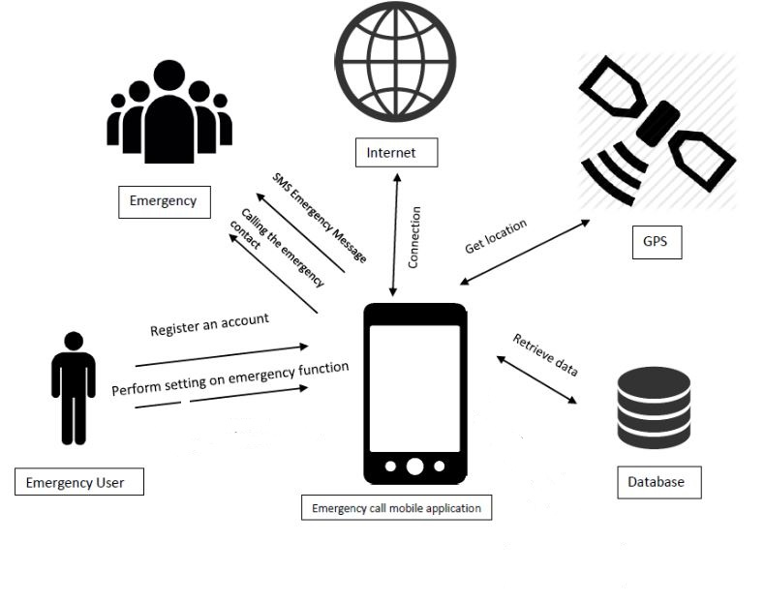
Planning

Slide 12
Project Planning:
Time Schedule:
Week-1:UI design
Week-2:Commands/code
Week-3:Execution
Week-4:Testing and Documentation
Week-5:Verification

Slide 13
Continued…
Modules:
User:
Register
Login
Set Contacts
Set Emails
Set message contents
Send messages

Slide 14
Requirements:
Software Requirements:
Operating System: Windows 7,Linux
Application Software: Android Studio.
Programming Languages : Java , Javascript , XML, PHP.
Online Services : GPS , Emails.
Hardware Requirements:
4 GB RAM.
1 GB Hard disk.
Android Phone

Slide 15
References:
[1] Zabiullah khan, International Journal of Advanced Research In Computer Science, 5 (3), March–April, 2014,89-94
[2]https://www.researchgate.net/profile/Bharat_Sharma26/publication/305476341_00_alo_all_pages/links/5790ab4808ae64311c1199a3/00-alo-all-pages.pdf
[3]https://play.google.com/store/apps/details?1d=com.clarity.eap.alert

Slide 16
Thank you
Queries
?

